Slide 1
HR Attrition Analysis
Why do employees leave?
Behind every resignation is a story: what happened and why it happened.
That’s what the next pages set out to find.
Done by Muhammed Ateff
Notes:
Open with the question. The dataset is the public IBM HR Analytics sample (1,470 employees); the design is a Teleperformance-inspired concept, not affiliated.

Slide 2
From raw HR data to a clear attrition story
1
2
3
4
Clean
Model
Measure
Visualize
Power Query
Star schema
DAX KPIs
3 report pages
Removed constant and noise columns, fixed data types, built age and income bins and 0/1 flags.
One fact table and eight dimensions, all one-to-many with single-direction filters.
Attrition rate, overtime rate, early attrition, high-performer attrition and more.
Overview, root causes, and retention vulnerabilities, with navigation and a detail drill-through.
Data contain 1,470 employees.
Notes:
Walk the four steps quickly; the point is that the findings sit on a clean, well-modelled base.

Slide 3
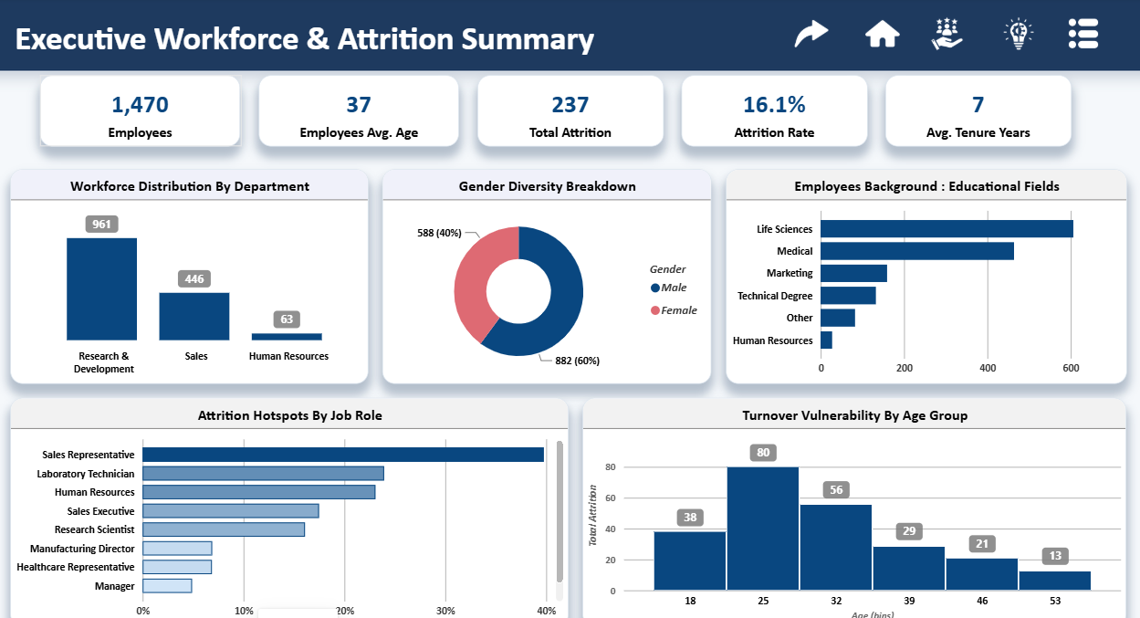
Workforce Attrition Summary
16.1%
Attrition rate
237
Employees who left
1,470
Employees in the dataset
Average age of employees is 37 and average tenure is 7 years. Research & Development is 65% of staff (961 people).
Notes:
Set the baseline: 16.1% attrition. Everything after this asks who is above that line and why.

Slide 4
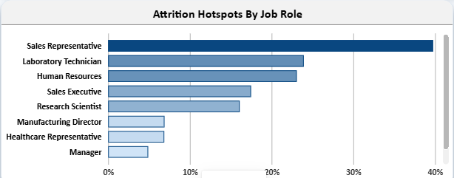
Sales Representatives leave at 2.5× the company rate
~40%
attrition rate for Sales Representatives, against 16.1% company-wide
Laboratory Technician (~24%) and Human Resources (~23%) follow
Managers (~5%) and Healthcare Representatives (~7%) are the most stable
Rates, not headcounts, show where the risk sits: a big role can have many leavers and still a normal rate.
Notes:
Source: Overview page, Attrition Hotspots By Job Role (rate by role). Read values are approximate, from the chart axis.

Slide 5
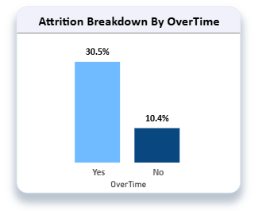
Overtime triples the chance of leaving
28%
54%
of employees work overtime (416 / 1470 )
of leavers worked overtime (127 of 237)
Overtime workers are about a quarter of the workforce but over half of the people who left. Workload is the clearest lever in this data.
Notes:
30.5% is the OverTime Attrition Rate KPI. The 10.4% comparison is calculated from the report's counts: 110 leavers among 1,054 employees without overtime.

Slide 6
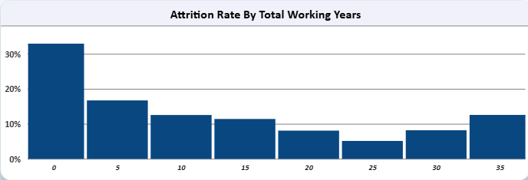
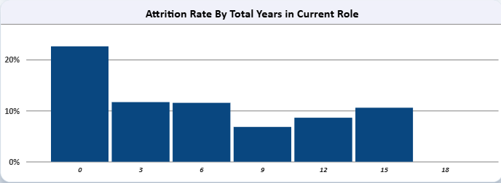
Attrition peaks early in careers and in new roles
About 1 in 3 employees with under 5 years of total experience leaves.
Employees new to their current role leave at roughly 22%, the highest of any tenure group.
102
leavers are classed as early attrition: 43% of everyone who left.
Notes:
Source: Workforce Retention Vulnerabilities page. 102 of 237 leavers is 43%.

Slide 7
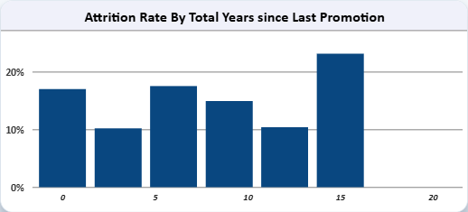
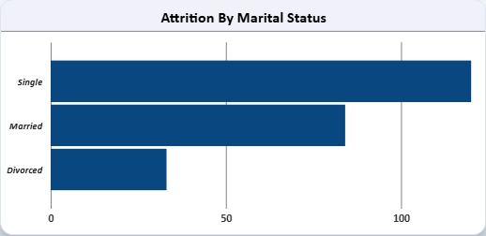
Long waits for promotion lift the risk again
The attrition rate climbs to about 23% for employees waiting longest for a promotion.
Single employees are 120 of the 237 leavers (51%). This chart shows counts, not rates.
Notes:
Be explicit that these are signals, not causes. This is also the honest limit of a single-snapshot dataset.

Slide 8
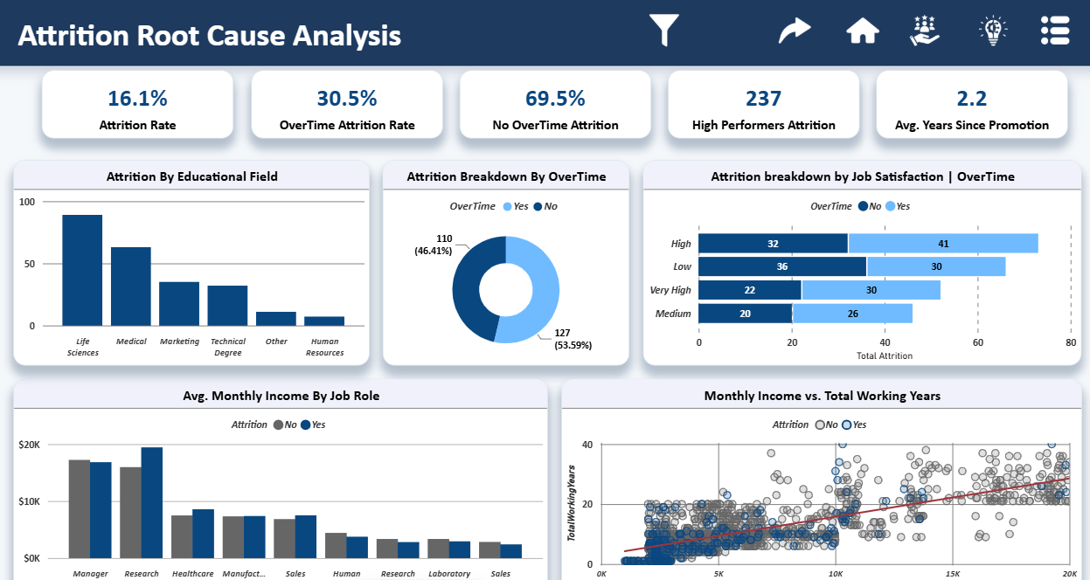
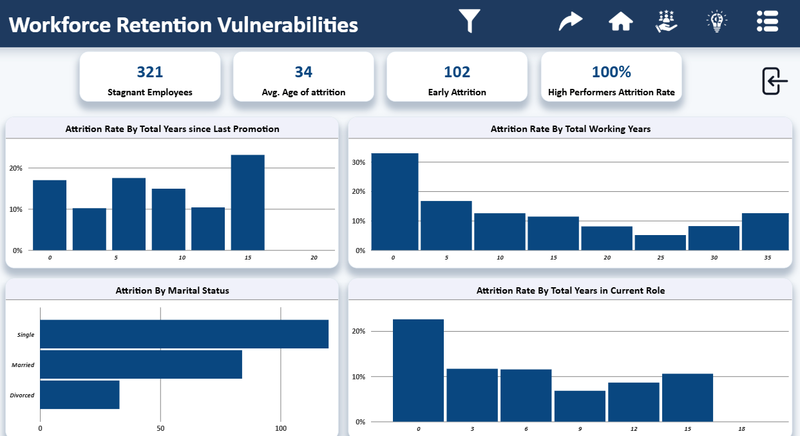
The report: three pages, one story
Overview
Attrition Root Cause Analysis
Workforce Retention Vulnerabilities
Who we are and where attrition sits.
How overtime, satisfaction, income and role relate to leaving.
Tenure, promotion and role signals, with a drill-through to employee detail.
Notes:
Offer a live walkthrough of the Power BI report here.

Slide 9
Recommended Actions :-
1
Reduce overtime where it concentrates
Overtime workers leave at 30.5% against about 10%. Start with the roles carrying the most overtime.
2
Protect the first two years
43% of leavers are early attrition. Add structured onboarding, mentoring and early check-ins.
3
Review promotion paths
The rate climbs to about 23% for the longest wait since promotion. Set a review point for long-tenured, non-promoted staff.
4
Build a plan for Sales Representatives
About 40% attrition, 2.5× the company rate. Look at workload, pay and career path together.
Notes:
Frame these as hypotheses to test, which is what a good analyst would say.

Slide 10
Thanks
Muhammed Ateff
Notes:
Close by inviting questions and offering the live Power BI walkthrough.

Slide 11
The SQL task :-
Select Department , Count(*) as Attrition_Count
From Attrition_data
Where Attrition = “Yes”
Group by 1
Order by 2 Desc

